Slide 1

The greatest books ever written are already free.
Notes:
[0:00–0:10] The greatest books ever written are already free. They've lasted hundreds of years because they tell the truth about being human.

Slide 2
So why aren't we reading them?
A phone in every hand on every train. The classics, one tap away, and untouched.
Notes:
[0:10–0:22] So why aren't we reading them? Look around any subway car: a phone in every hand. The classics are one tap away, and almost nobody opens them. I want to help people get the reading habit back.

Slide 3
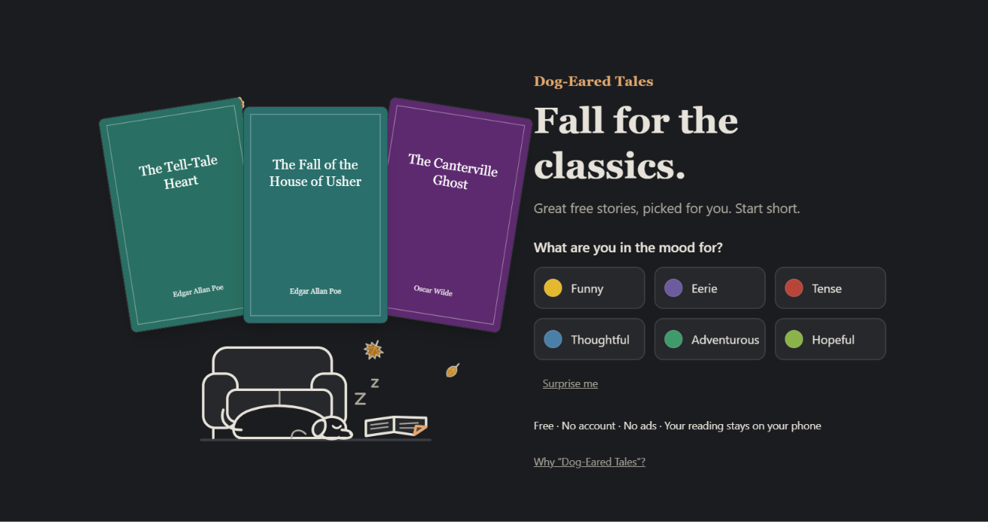
Dog-Eared Tales: tap a mood, read before your stop.
Notes:
[0:22–0:42] This is Dog-Eared Tales. A free reading app with 185 short classics, made for phones and commutes. Tap a mood, and it picks a story you can finish before your stop. Swipe to turn the page. Dog-ear it to keep it. No account, no ads, and your reading stays on your phone.

Slide 4
But most descriptions give away the ending.
And parents can't tell what's inside.
Notes:
[0:42–0:52] But choosing a classic is hard. Most descriptions give away the ending, and parents can't tell what's inside a story before handing it over.

Slide 5
Story Guide: Gemma 4 never sees the ending
First third
Hook and blurb
Whole story
Notes and age band
Notes:
[0:52–1:10] So I built Story Guide, an open-source tool powered by Gemma 4. For the hook and blurb, Gemma only reads the first third of the story, so it can't spoil a twist it has never seen. Then it reads the whole story to rate the content and suggest an age band.

Slide 6
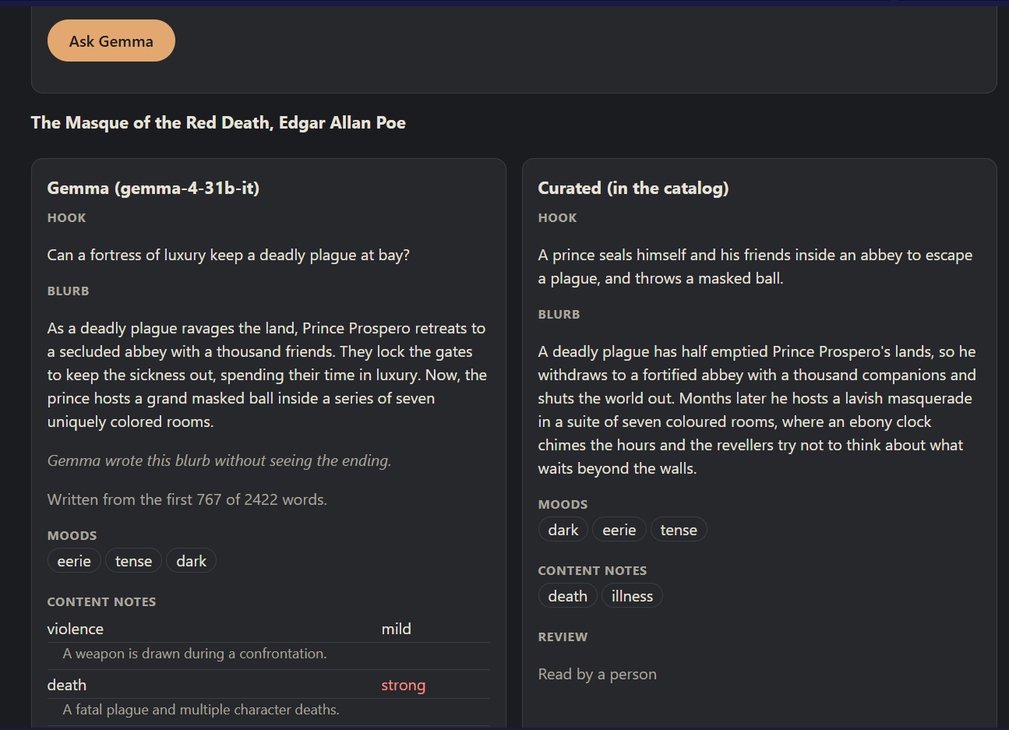
A spoiler-free blurb, and notes a parent can use.
Notes:
[1:10–1:32] Here it is on Poe's "The Masque of the Red Death". Gemma's blurb sets the scene without the ending, right beside the human-curated version. It rates violence, death, frightening scenes, sexual themes, period language and animal harm, says why, and suggests 13 and up, with a reason a parent can actually use.

Slide 7
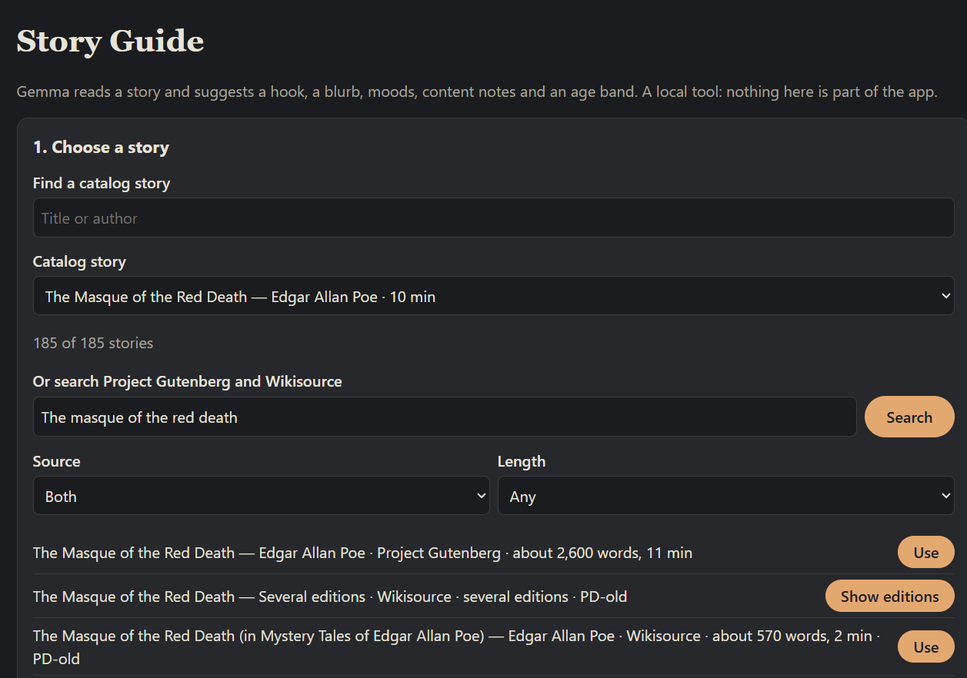
Project Gutenberg and Wikisource, filtered by length.
Notes:
[1:32–1:48] And it isn't limited to the app. Story Guide searches Project Gutenberg and Wikisource, filters by length, so you can find something short enough for a commute, and describes any public-domain story in seconds.

Slide 8
Open model. Open code. Free classics.
MIT licence. Public-domain texts only. And it respects each library's terms.
Notes:
[1:48–2:00] Everything is open: an open model, MIT-licensed code, and public-domain texts. It even respects each library's terms. If a library asks AI tools not to fetch its books, we don't.

Slide 9
Dog-Eared Tales
+ Story Guide
dog-eared-tales.rajivsundar.workers.dev
github.com/rajivsundar/dog-eared-tales
Notes:
[2:00–2:10] Dog-Eared Tales and Story Guide. One short story at a time, back to the reading habit.

